Slide 1
Regression Analysis
Simple Linear Regression
Nicoleta Serban, Ph.D.
Professor
School of Industrial and Systems Engineering
Testing the Theory of Purchasing Power Parity (Part 1)

Slide 2

About This Lesson

Slide 3

Testing the Theory of Purchasing Power Parity
Acknowledgment: This example was made available by Dr. Jeffrey Simonoff from the New York University.

Slide 4
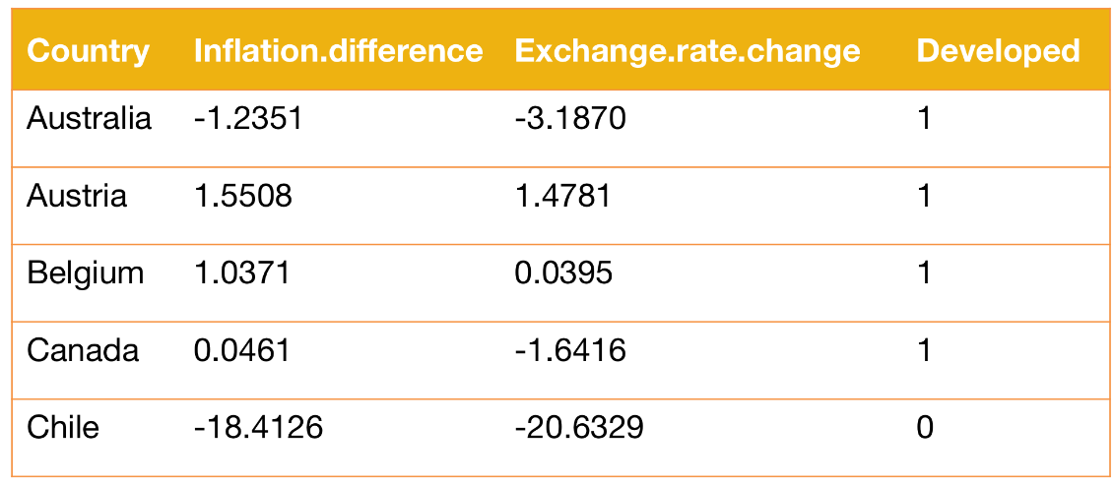

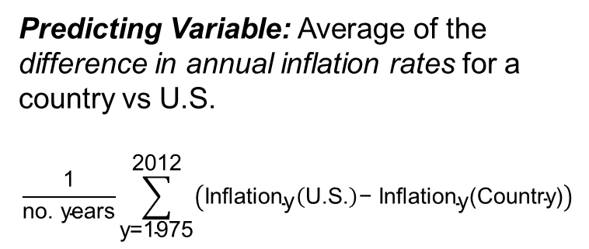
Regression Variables
Response Variable: Average annual change in the exchange rate
$\frac{\text{ln}\left(\text{Exclange} \text{Rate} \text{for}\text{ 2012}\right)\text{−}\text{ln}\text{(}\text{Exchange} \text{Rate} \text{for}\text{ 1975)}}{\text{no}\text{. }\text{years}}$ % = Annualized Percentage Change
Predicting Variable: Average of the difference in annual inflation rates for a country vs U.S.
$$\frac{\text{1}}{\text{no}\text{. }\text{years}}\sum_{\text{y}\text{=1975}}^{\text{2012}}{\left({\text{Inflation}}_{\text{y}}\left(\text{U}\text{.}\text{S}\text{.}\right)\text{− }{\text{Inflation}}_{\text{y}}\text{(}\text{Country}\text{)}\right)}$$

Slide 5
Read the Data in R
# Use read.table R command: pay attention to the file type to use the correct read file!#
ppp = read.table("ppp.dat",sep="\t", header=T, row.names=NULL)
## How many countries?
dim(ppp)
[1] 40 4
## Brazil is an outlier and it was not included in the data set initially; I am adding it back as follows
Addp = data.frame("Brazil",-76,-73,0)
names(addp) = names(ppp)
## Save the data variables to be recognized by R as separate variables
ppp = data.frame(rbind(ppp,addp))
attach(ppp)
## Re-label the ‘Developed’ column to differentiate between Developed and Developing countries
Developed[Developed==1] = "Developed"
Developed[Developed==0] = "Developing"

Slide 6
Exploratory Data Analysis in R
# Evaluate the Linear Relationship: Perform a scatter plot of the two variables
plot(Inflation.difference,Exchange.rate.change, main="Scatterplot of Exchange rate change vs Inflation difference", xlab="Inflation difference",ylab="Exchange rate change")
# Evaluate differences between developed and developing countries
boxplot(Exchange.rate.change~as.factor(Developed), main="Boxplot of Exchange rate change by Developed vs Developing Countries",xlab="Country Class",ylab="Exchange rate change")

Slide 7
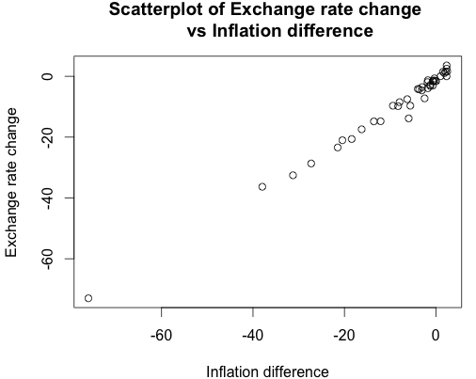
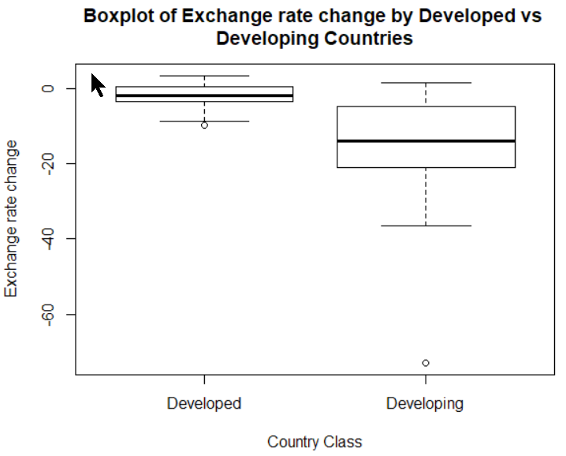
Exploratory Data Analysis in R

Slide 8
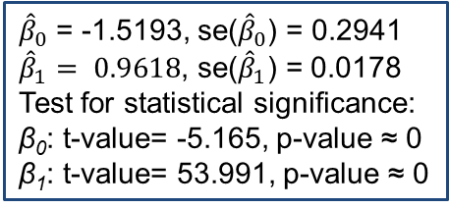

Fitting Linear Regression in R
pppa = lm(Exchange.rate.change ~ Inflation.difference) ## regression model
summary(pppa)
Coefficients:
Estimate Std. Error t value Pr(>|t|)
(Intercept) -1.51930 0.29415 -5.165 7.43e-06
Inflation.difference 0.96185 0.01781 53.991 < 2e-16
---
Residual standard error: 1.646 on 39 degrees of freedom
Multiple R-squared: 0.9868, Adjusted R-squared: 0.9865
F-statistic: 2915 on 1 and 39 DF, p-value: < 2.2e-16
${\hat{β}}_{0}$ = -1.5193, se(${\hat{β}}_{0}$) = 0.2941
${\hat{β}}_{1}= 0.9618$, se(${\hat{β}}_{1}$) = 0.0178
Test for statistical significance:
β₀: t-value= -5.165, p-value ≈ 0
β₁: t-value= 53.991, p-value ≈ 0
$\hat{σ}$ = 1.646, n-2 = 39
R² = 98.7% variability explained

Slide 9
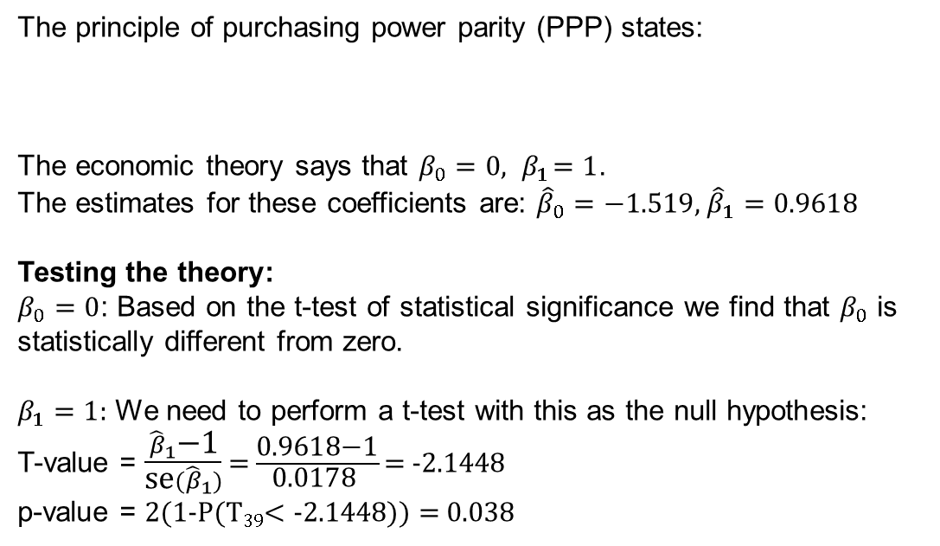
Does the Theory Hold?
The principle of purchasing power parity (PPP) states:
The economic theory says that $β_{0}=0, { β}_{1}=1$.
The estimates for these coefficients are: ${\hat{β}}_{0}=−1.519$, ${\hat{β}}_{1}=0.9618$
Testing the theory:
$β_{0}=0$: Based on the t-test of statistical significance we find that $β_{0}$ is statistically different from zero.
$β_{1}=1$: We need to perform a t-test with this as the null hypothesis:
T-value = $\frac{{\hat{β}}_{1}\text{−1}}{\text{se}({\hat{β}}_{1})}$ = $\frac{\text{0.9618−1}}{\text{0.0178 }}\text{=}$ -2.1448
p-value = 2(1-P(T₃₉$<$ -2.1448)) = 0.038
Violations of PPP theory with respect to both the intercept and the slope.
Average annual change
in the exchange rate
=
Difference in average
annual inflation rates
+
Random error

Slide 10
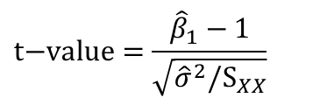
Hypothesis Testing in R
# Perform the hypothesis test for slope coefficient H0: slope=1
# use the library ‘car’ available in R (you need to install this library first then download it)
install.packages("car")
library(car)
linearHypothesis(pppa,c(0,1),rhs=1)
## Alternatively, you can compute the t-value and p-value as follows:
tvalue = (0.9618−1)/0.01781
pvalue = 2*(1-pt(abs(tvalue),39))
## Use the help menu to learn more about the functions used above:
help(pt)
help(linearHypothesis)
P-value = 2P(T_{n-2} > |t-value|) where
$$t\text{−}value=\frac{{\hat{β}}_{1}−1}{\sqrt{{\hat{σ}}^{2}/S_{XX}}}$$

Slide 11

Summary

